Slide 1
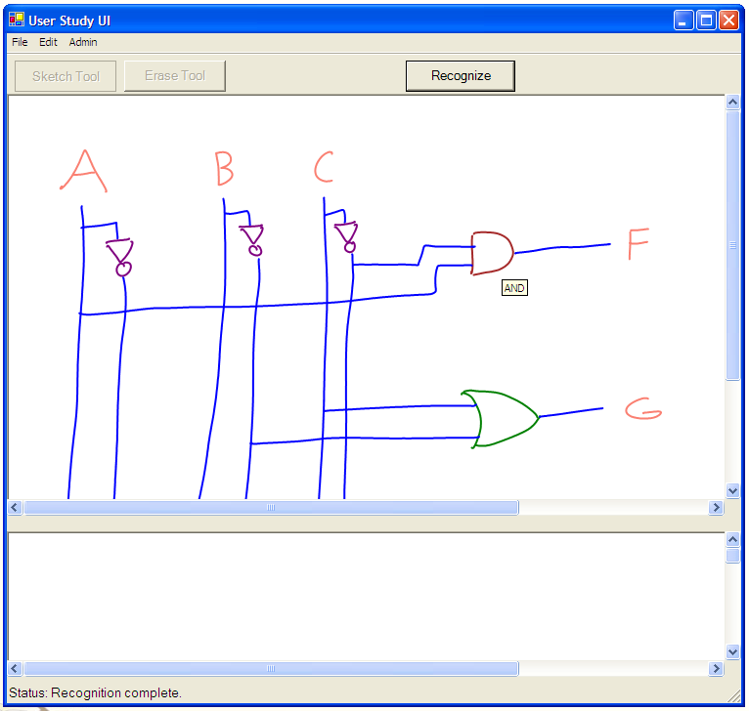
A User Interface for Circuit Design
How do we want our application to look and feel?

Slide 2
Interface Overview
Standard Menus
Recognition Trigger
(Pen Tip)
Sketch Panel
Notes Panel

Slide 3
A Typical Usage Scenario

Slide 4
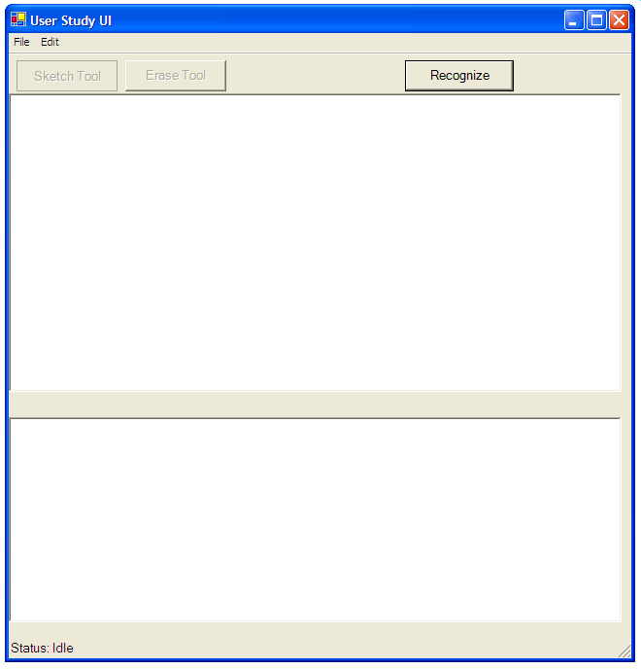

Slide 5
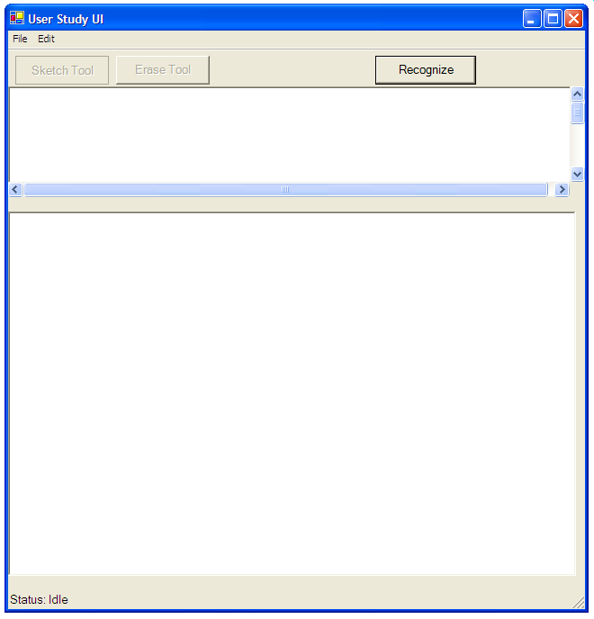

Slide 6
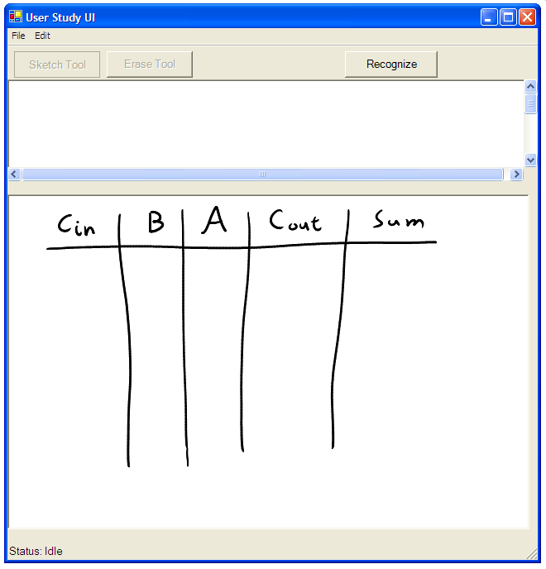

Slide 7
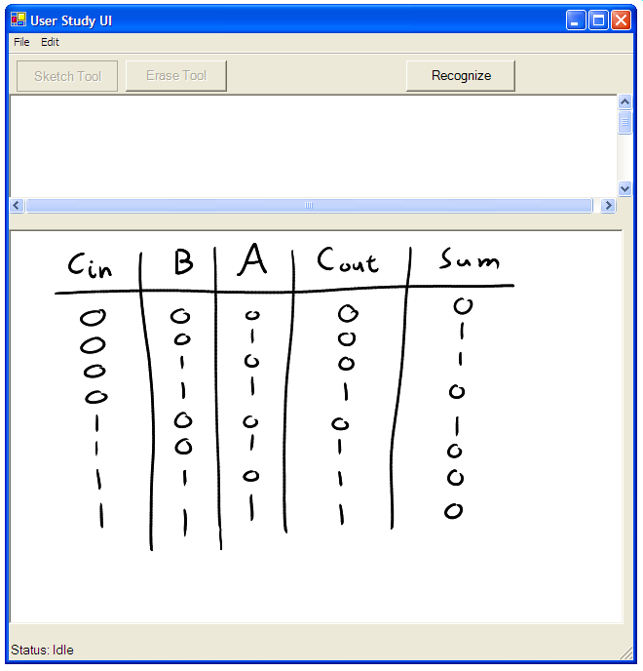

Slide 8
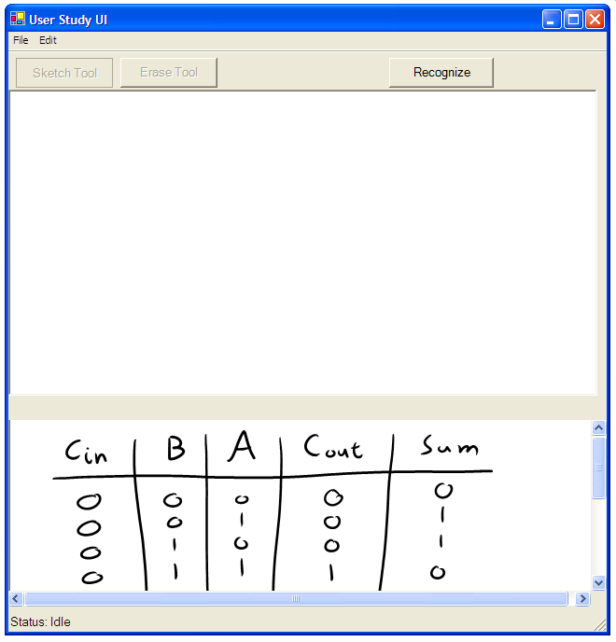

Slide 9
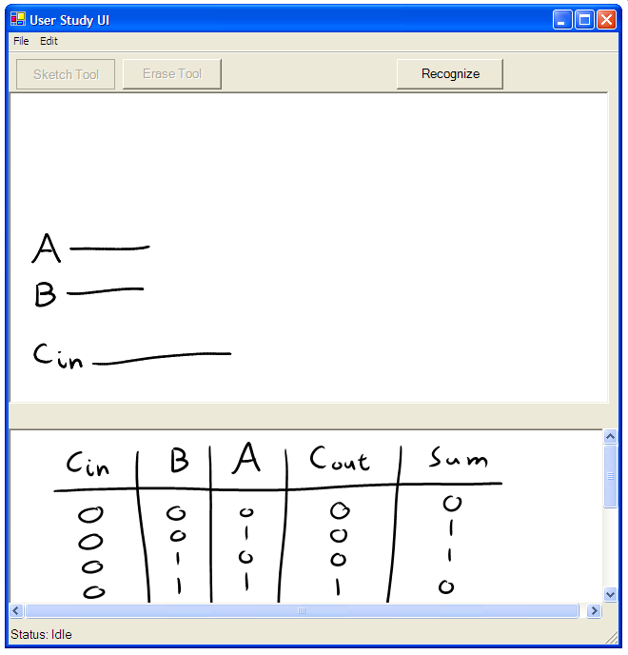

Slide 10
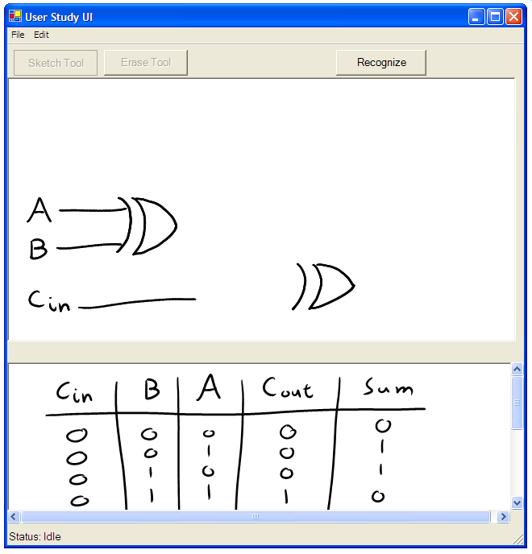

Slide 11
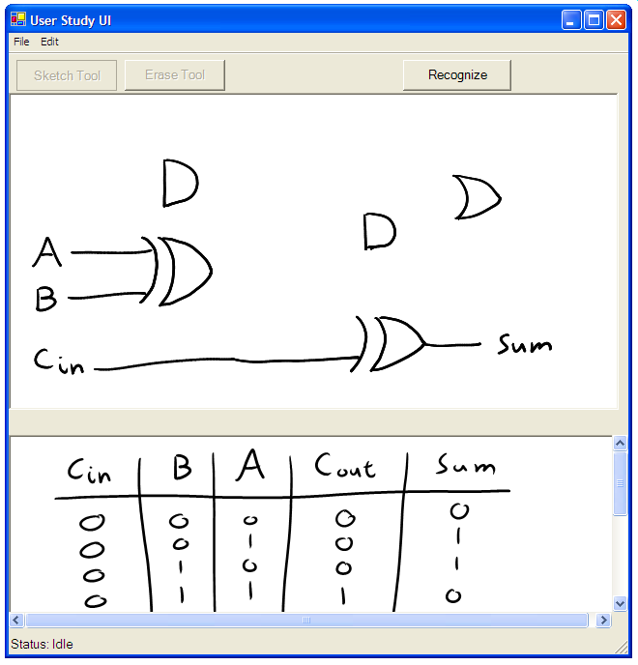

Slide 12
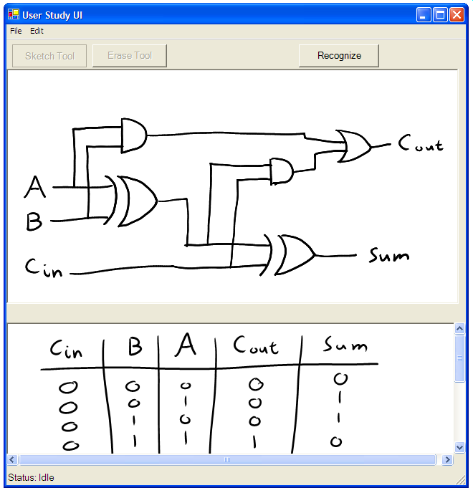

Slide 13
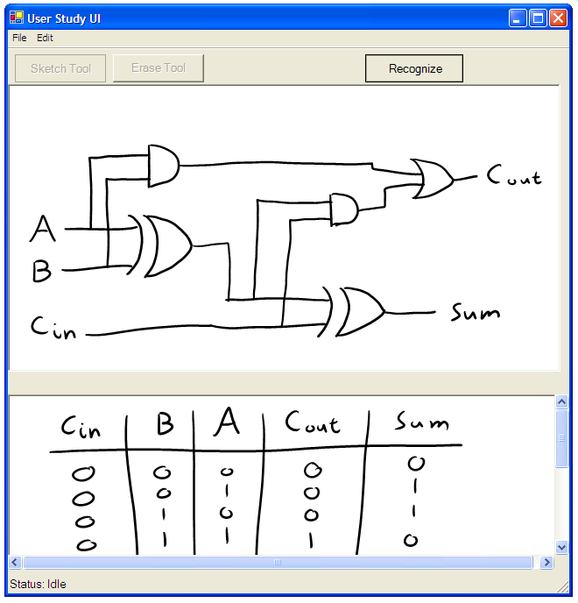

Slide 14
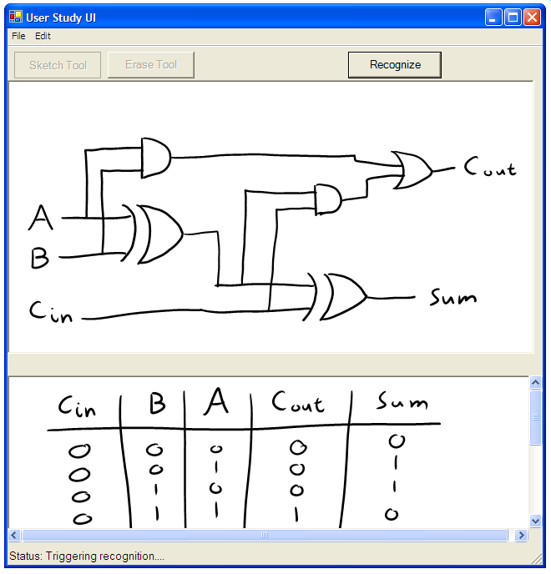

Slide 15
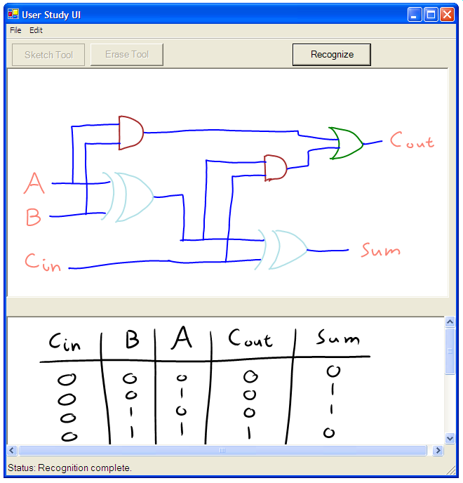

Slide 16
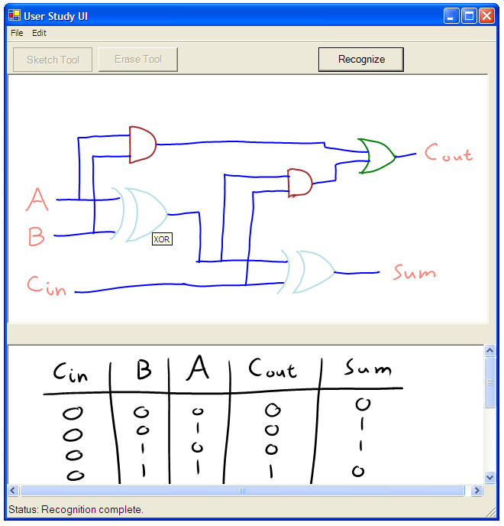

Slide 17
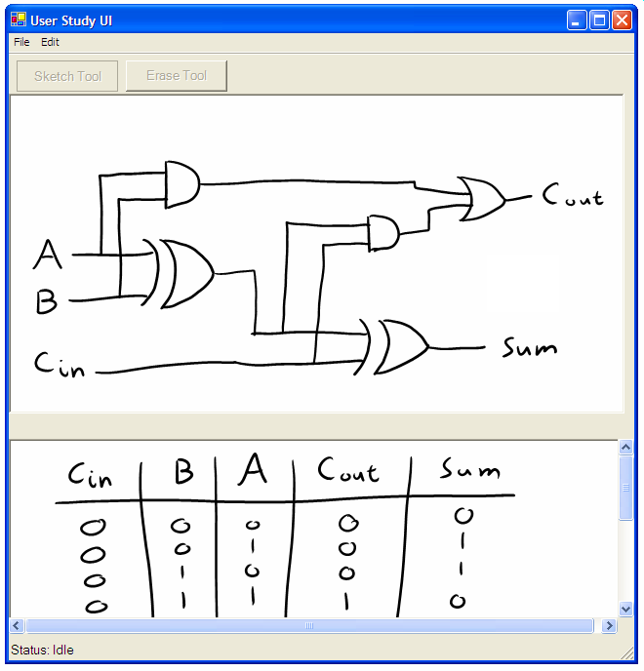

Slide 18
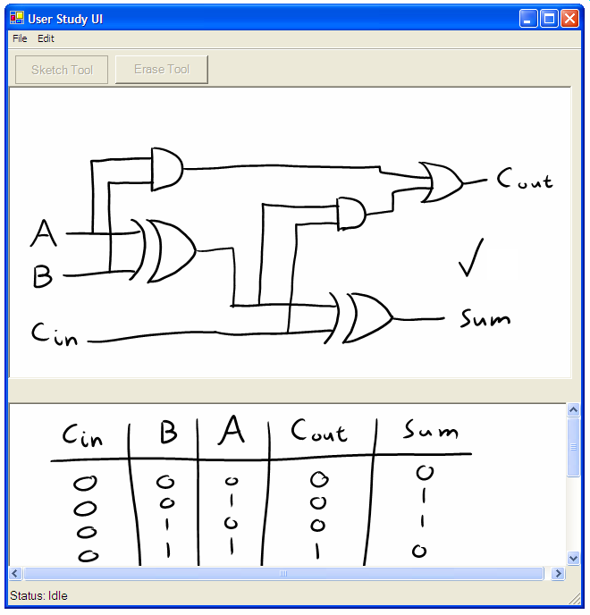

Slide 19


Slide 20
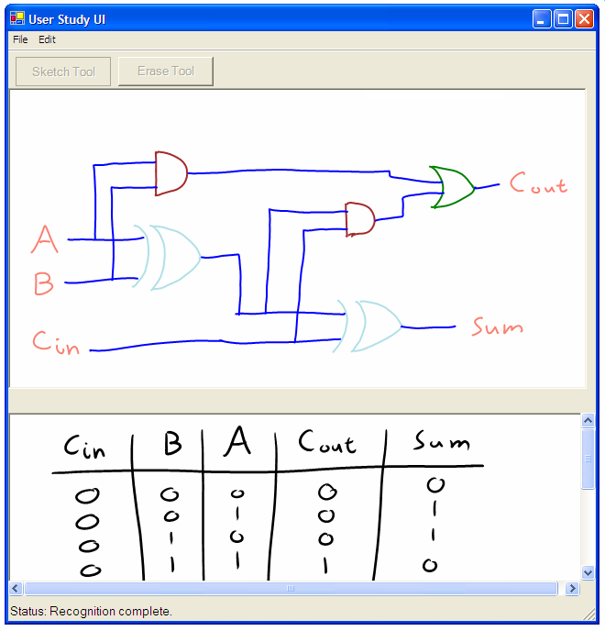

Slide 22
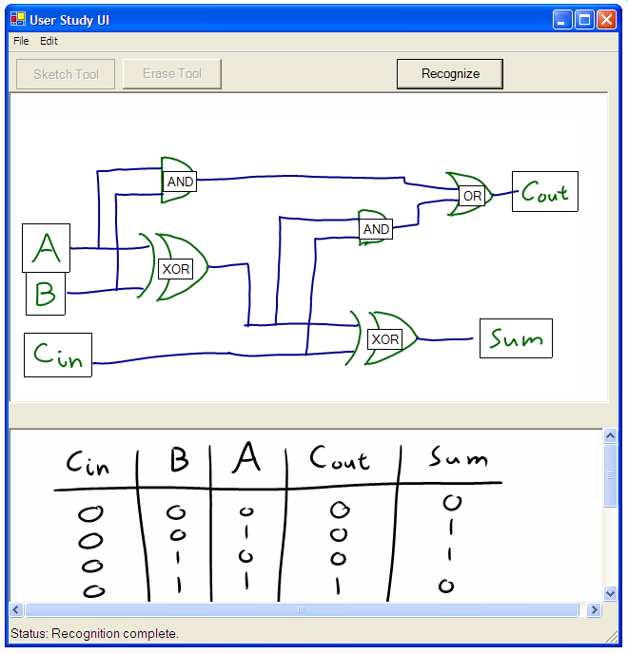

Slide 23
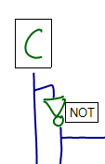



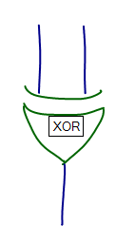

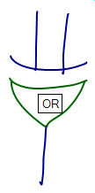
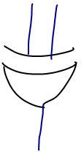
Study of User Interface Elements
Recognition Triggers
Feedback Mechanisms
Error Types
Correct
Mislabel
Grouping Error
Omission

Slide 24
Study of User Interface Elements
Recognition Triggers
Feedback Mechanisms
Error Types
Correct
Mislabel
Grouping Error
Omission

Slide 25
Study of User Interface Elements
Recognition Triggers
Feedback Mechanisms
Error Types
Correct
Mislabel
Grouping Error
Omission
(False Positive)
(False Negative)

Slide 26
Study of User Interface Elements
Recognition Triggers
Feedback Mechanisms
Error Types
Correct
Mislabel
Grouping Error
Omission

Slide 27
Experimental Design
User Domain Analysis
  Truth table tasks
Observables
  Qualitative user feedback
  Survey results
Task T1
Please draw a circuit diagram for the following truth table:
Inputs |  |  | Outputs
A | B | C | F | G
0 | 0 | 0 | 0 | 0
0 | 0 | 1 | 1 | 0
0 | 1 | 0 | 0 | 1
0 | 1 | 1 | 0 | 0
1 | 0 | 0 | 0 | 0
1 | 0 | 1 | 0 | 0
1 | 1 | 0 | 0 | 1
1 | 1 | 1 | 0 | 0

Slide 28

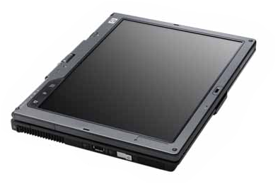
Wizard of Oz Methodology
User Machine
User Draws Circuit
Network
Connection
Wizard Machine
Wizard Simulates
Recognition

Slide 29
Results: Workflow
Write Notes and Equations
Draw Circuit
8 out of 9 participants
use the
same design workflow
Trigger Recognition
Correct Errors
Trigger Recognition Again
Notes:
Explain what the 9th user did

Slide 30
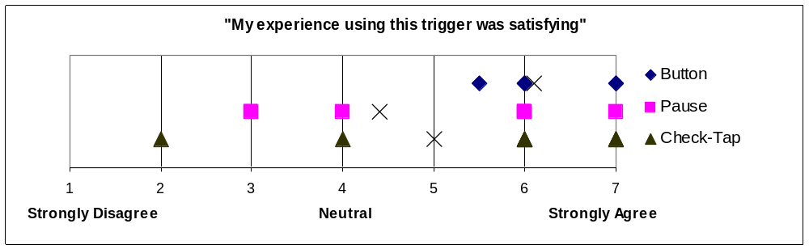
Results: Recognition Triggers
Button Trigger had highest satisfaction

Slide 31
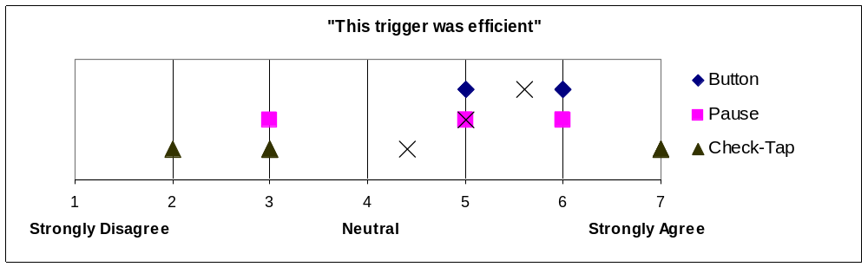
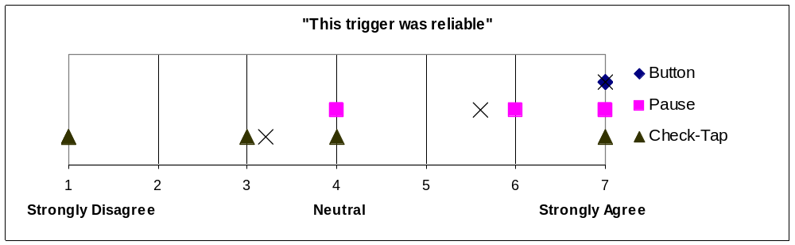
Results: Recognition Triggers
Button Trigger was not necessarily the most efficient trigger
Button Trigger was most reliable. Average Check-Tap gesture success rate: 1 in 5.

Slide 32
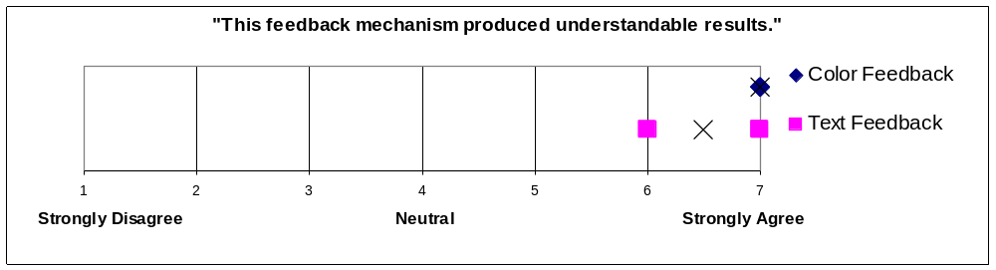
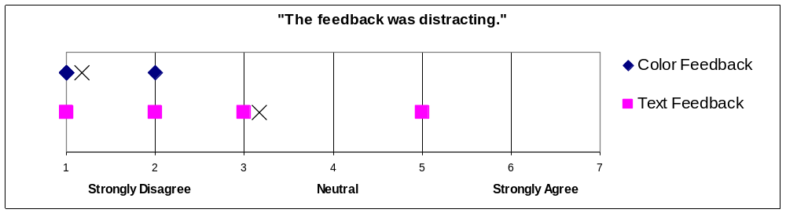
Results: Feedback Mechanisms
5 of 6 users preferred color feedback to text feedback.
Students mention the learning curve for color feedback is a non-issue

Slide 33
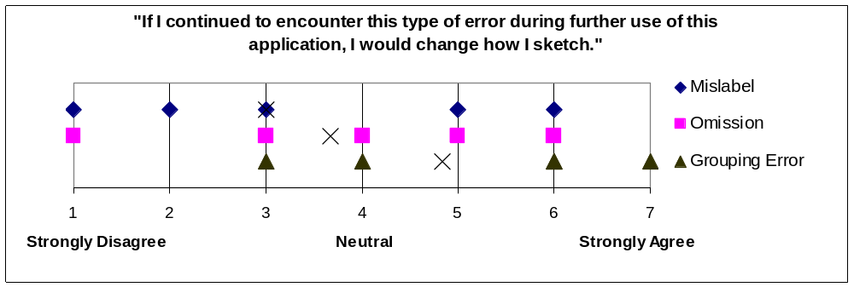
Results: Error Types
Participants tended to see grouping errors as their own fault; mislabel and omission errors were the machine’s fault
4 of 6 users found 15% error rate acceptable; other 2 users would accept the tool if errors were more predictable

Slide 34
Conclusions
Front End
Prototype User Interface
User feedback informs future design
Hand-drawn
Sketch
Sketch Translation into Verilog
Foundation for simulation features
Recognize Symbols
Construct Circuit
Effective Grouping Algorithm
Groundwork for shape recognition
Translate to Verilog
Verilog file
Novel Labeling Tool
Supports data analysis and fuels
work in sketch recognition
Simulation (Xilinx)

Slide 35
Questions?

